Slide 1
Nonadiabatic molecular dynamics simulations in large scale nanomaterials and periodic solids
Mohammad Shakiba
SUNY Buffalo
Akimov Research Group

Slide 2

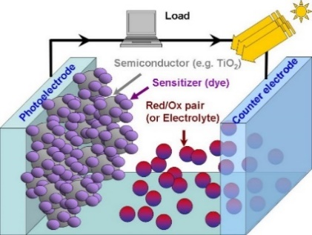


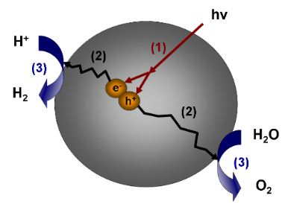
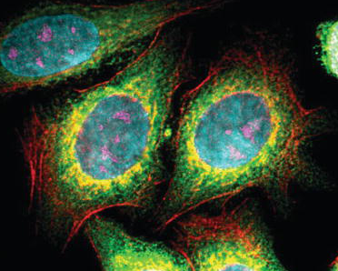
Motivation
Solar energy materials
Photocatalysis
Light-emitting diodes
Bio-imaging
Quantum dot size
Artificial leaf

Slide 3
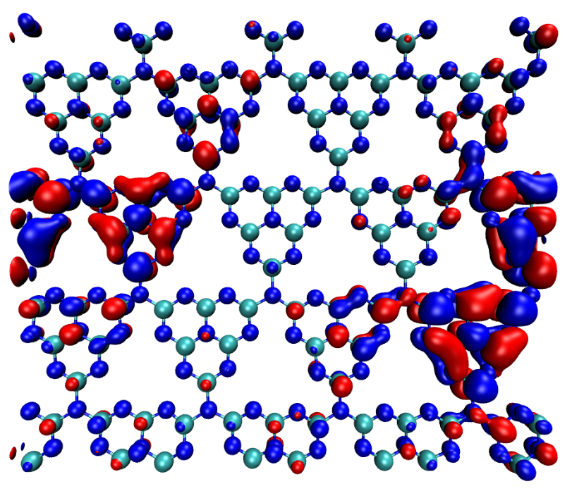
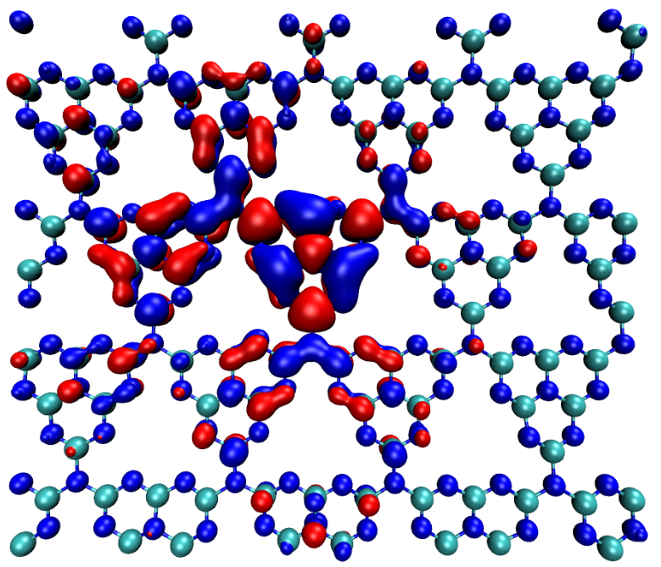
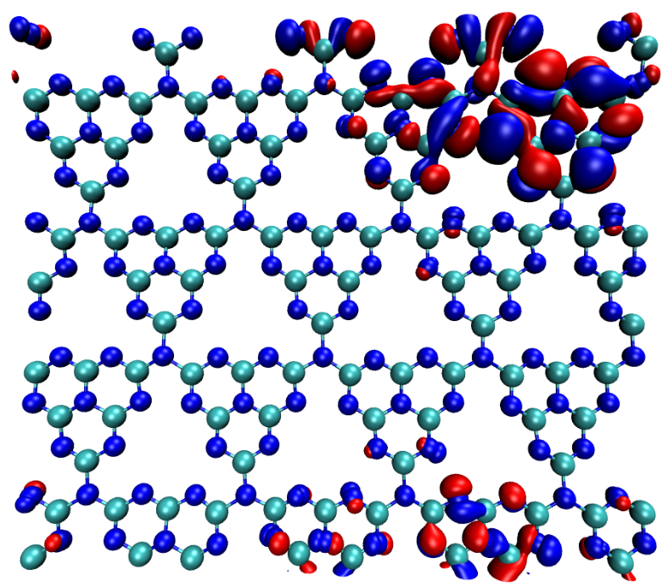
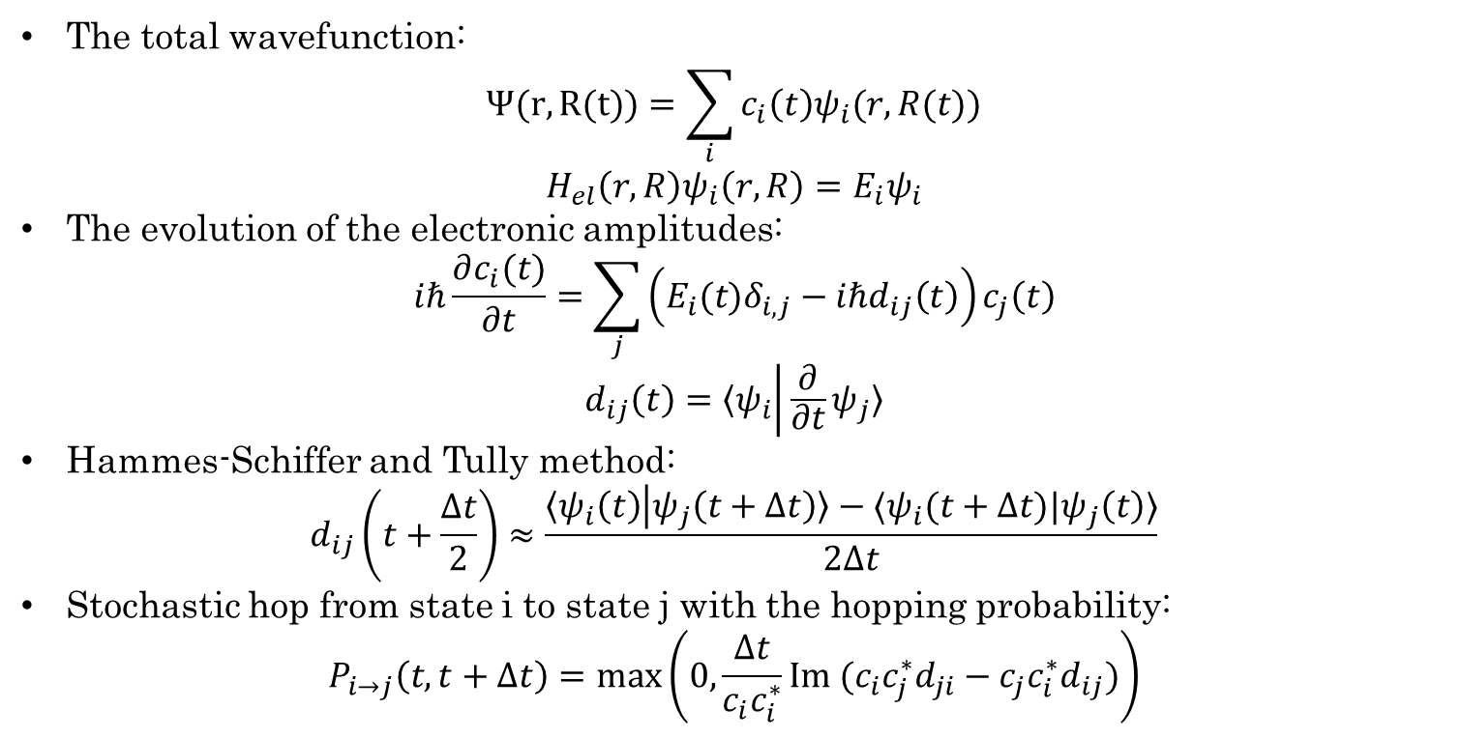
Nonadiabatic dynamics
e⁻
LUMO+1
The total wavefunction:
$$Ψ(r,R(t))=\sum_{i}{c_{i}\left(t\right)ψ_{i}(r,R(t))}$$
$$H_{el}\left(r,R\right)ψ_{i}\left(r,R\right)=E_{i}ψ_{i}$$
The evolution of the electronic amplitudes:
$$iℏ\frac{∂c_{i}(t)}{∂t}=\sum_{j}{\left(E_{i}(t)δ_{i,j}−iℏd_{ij}\left(t\right)\right)}c_{j}\left(t\right)$$
$$d_{ij}\left(t\right)=〈ψ_{i} | \frac{∂}{∂t}ψ_{j}〉$$
Hammes-Schiffer and Tully method:
$$d_{ij}\left(t+\frac{Δt}{2}\right)≈\frac{〈ψ_{i}\left(t\right) | ψ_{j}\left(t+Δt\right)〉−〈ψ_{i}(t+Δt)|ψ_{j}\left(t\right)〉}{2Δt}$$
Stochastic hop from state i to state j with the hopping probability:
$$P_{i→j}\left(t,t+Δt\right)=\max\left(0,\frac{Δt}{c_{i}c_{i}^{∗}}Im (c_{i}c_{j}^{∗}d_{ji}−c_{j}c_{i}^{∗}d_{ij})\right)$$
LUMO
e⁻
HOMO
h⁺
Tully, J. Chem. Phys. 1990, 93, 1061
Hammes‐Schiffer, Tully, J. Chem. Phys. 1994, 101, 4657–4667

Slide 4
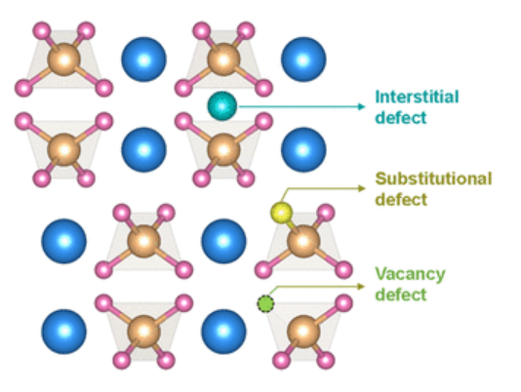
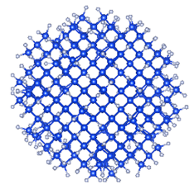
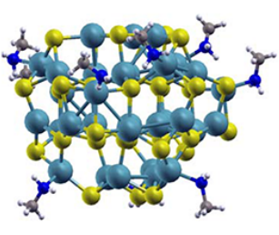
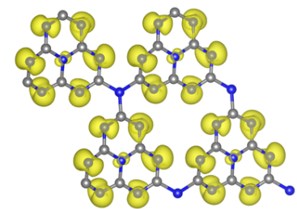
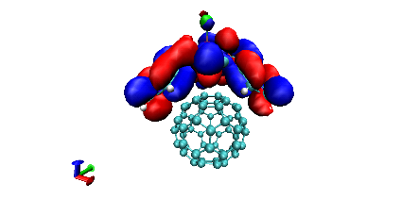
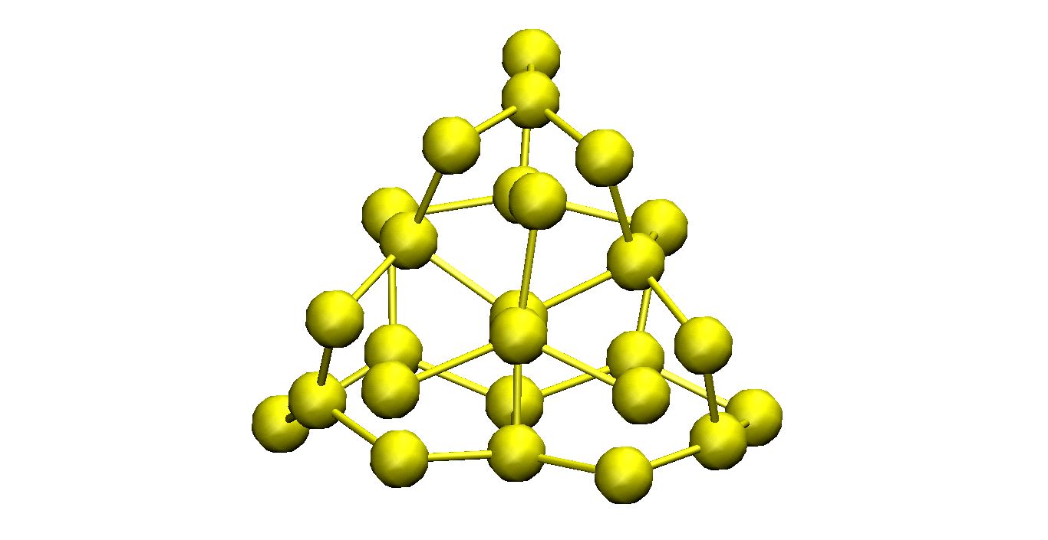
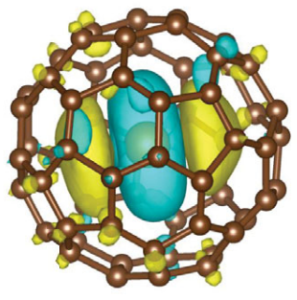
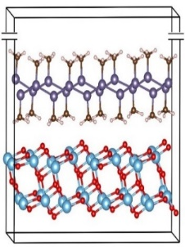
Challenges
Goal
NA-MD simulations are limited to small-medium sized structures
Nonadiabatic coupling (NAC) calculations are computationally expensive to calculate for a large number of states
To perform NA-MD calculations for large nanomaterials and periodic solids

Slide 5
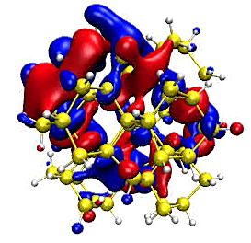
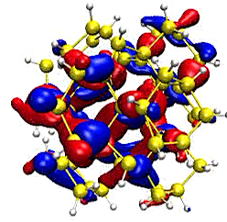
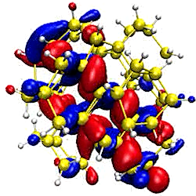
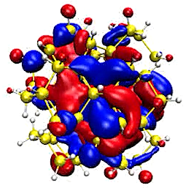

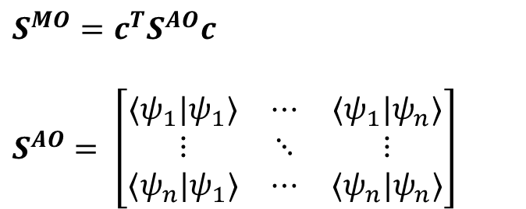
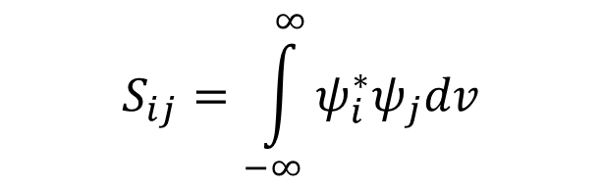
Time-overlap integration
Grid-based approach using .cube files
Easy to implement
Most codes can output these file
Not suitable for large structures with large number of states
Double-molecule approach
Easy to use and can be used in different codes
Very time-consuming for large structures
Not suitable for periodic structures
Analytical approach
Suitable for large systems and large number of states
Recurrence relations for computing integrals: Libint2 package
$$S_{ij}=\int_{−∞}^{∞}{ψ_{i}^{∗}ψ_{j}dv}$$
$$S^{MO}=c^{T}S^{AO}c$$
$$S^{AO}= \left[\begin{matrix}〈ψ_{1}|ψ_{1}〉 & ⋯ & 〈ψ_{1}|ψ_{n}〉 \\ ⋮ & ⋱ & ⋮ \\ 〈ψ_{n}|ψ_{1}〉 & ⋯ & 〈ψ_{n}|ψ_{n}〉\end{matrix}\right]$$
Smith, Shakiba, Akimov, J. Chem. Theory Comp. 2021, 17, 678–693
Libint, Version 2.6.0 Edward F. Valeev, http://libint.valeyev.net.
Shakiba, Stippell, Li, Akimov, J. Chem. Theory Compu. 2022, 18, 5157-5180

Slide 6
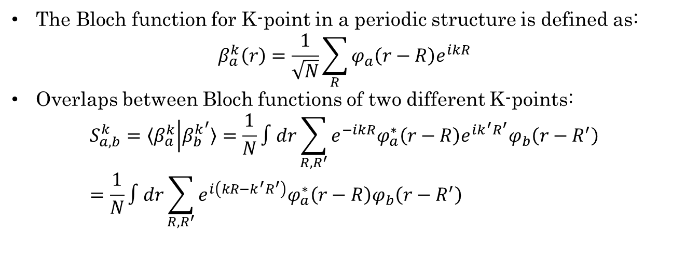
Extending to periodic structures and K-points
The Bloch function for K-point in a periodic structure is defined as:
$$β_{a}^{k}\left(r\right)=\frac{1}{\sqrt{N}}\sum_{R}{{φ_{a}\left(r−R\right)e}^{ikR}}$$
Overlaps between Bloch functions of two different K-points:
$$S_{a,b}^{k}=〈β_{a}^{k} | β_{b}^{k^{′}}〉=\frac{1}{N}∫dr\sum_{R,R^{′}}{e^{−ikR}φ_{a}^{∗}\left(r−R\right)e^{ik^{′}R^{′}}φ_{b}\left(r−R^{′}\right)}=\frac{1}{N}∫dr\sum_{R,R^{′}}{e^{i\left(kR−k^{′}R^{′}\right)}φ_{a}^{∗}\left(r−R\right)φ_{b}\left(r−R^{′}\right)}$$
Central
cell
MIL-125-NH₂
Aradi, Hourahine, Frauenheim, J. Phys. Chem. A 2007, 111, 5678–5684
Shakiba, Stippell, Li, Akimov, J. Chem. Theory Compu. 2022, 18, 5157-5180

Slide 7
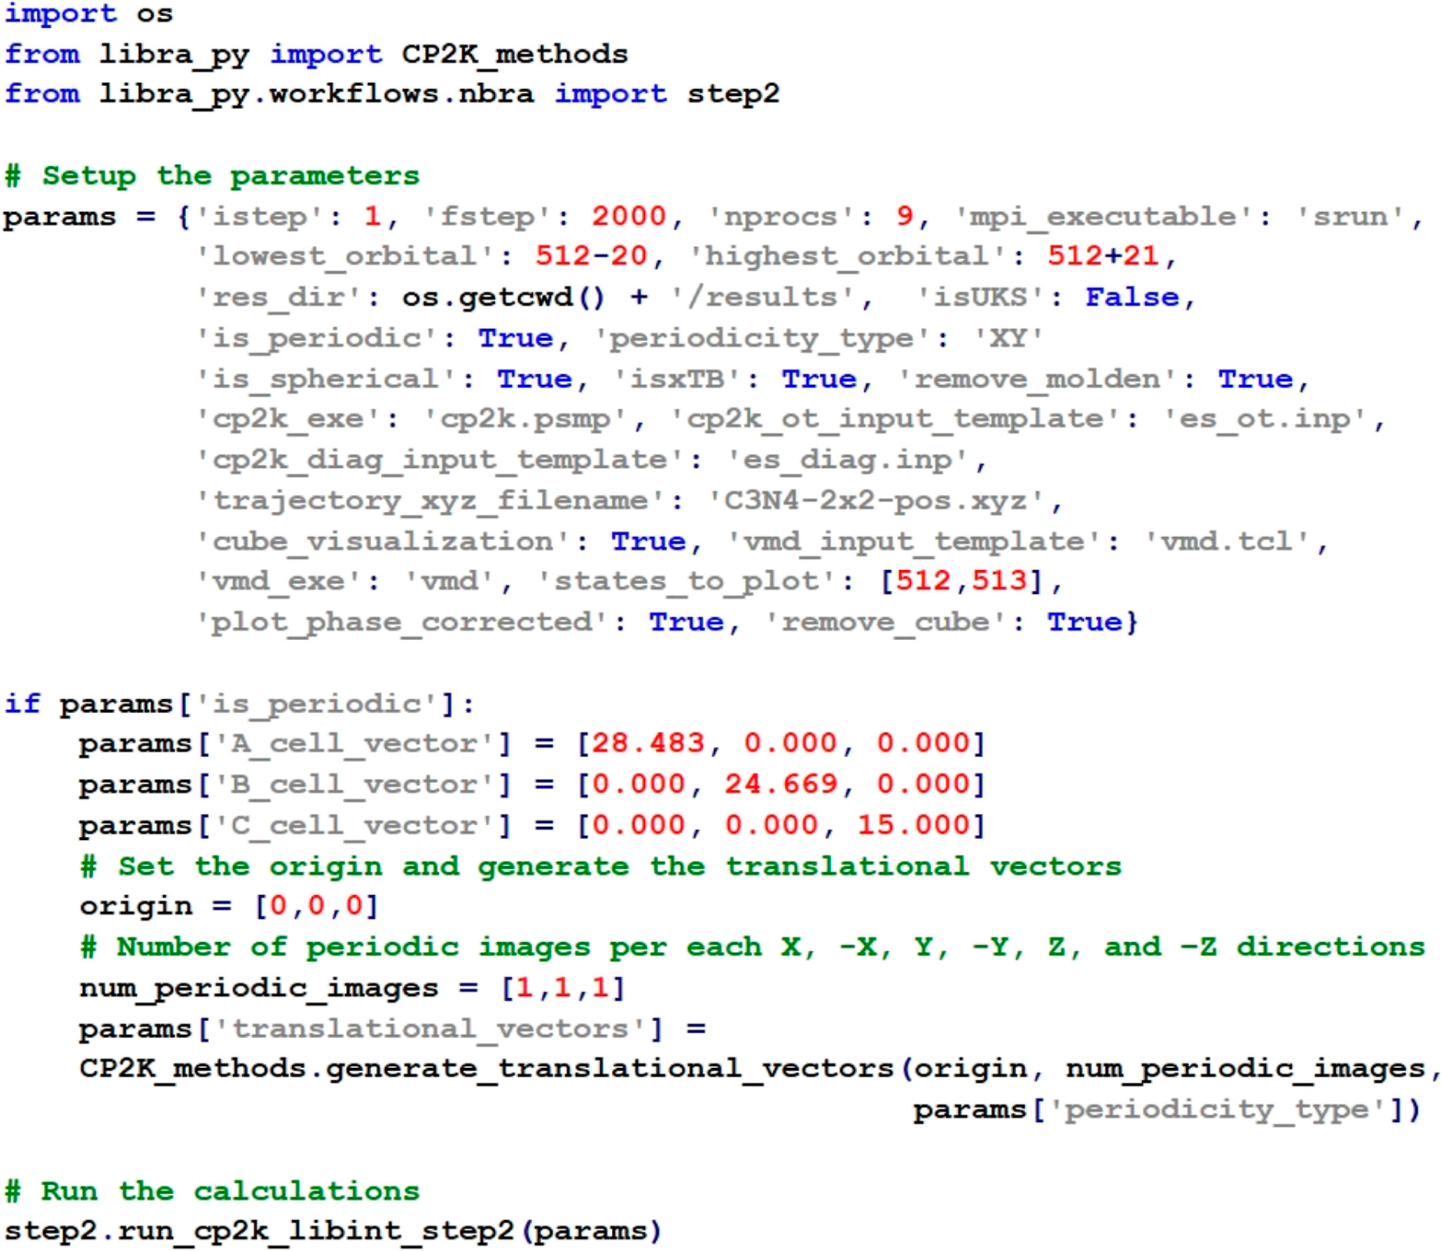
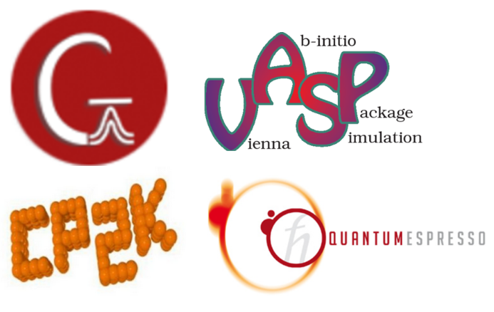




Implementation

Slide 8
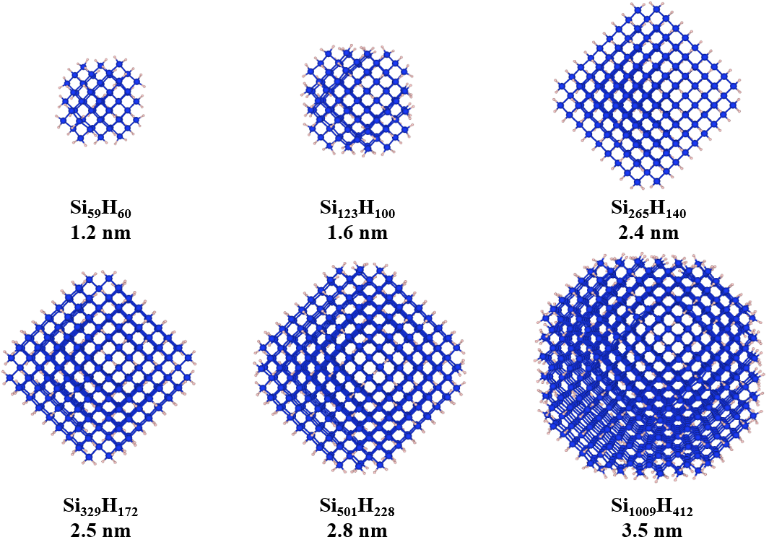
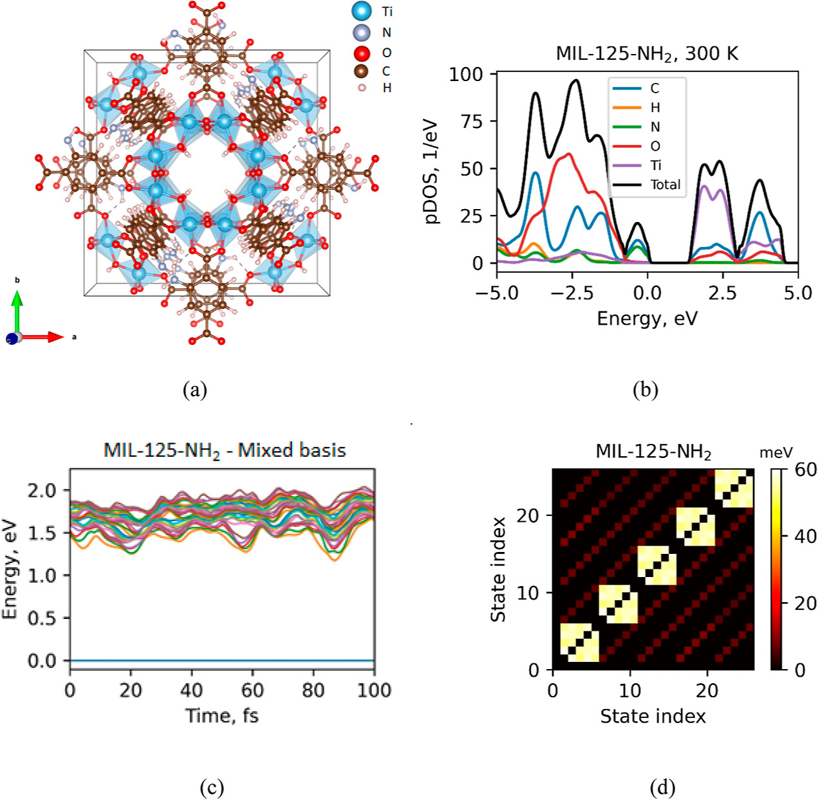
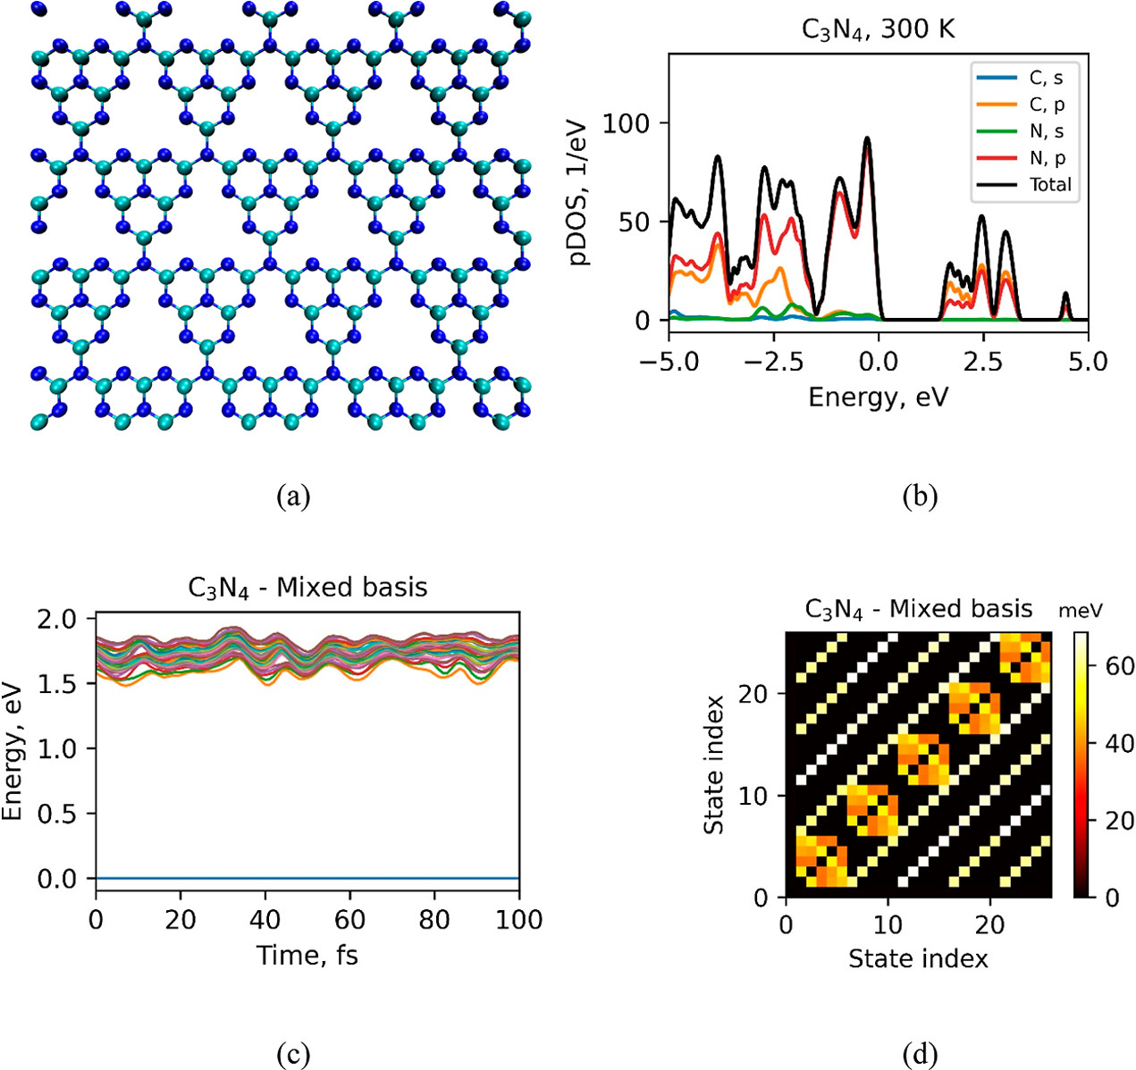
Applications
Hot-electron cooling dynamics in silicon nanocrystals (Si NCs)
Electron-hole recombination dynamics in metal organic frameworks and carbon nitride monolayers
Shakiba, Stippell, Li, Akimov, J. Chem. Theory Compu. 2022, 18, 5157-5180

Slide 9
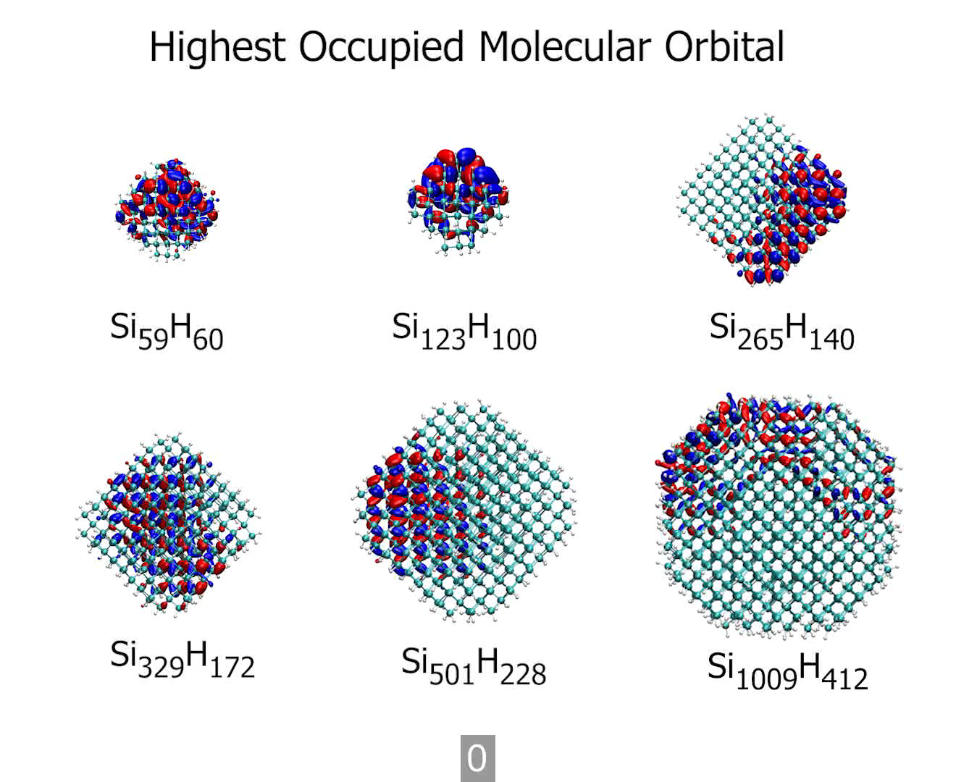
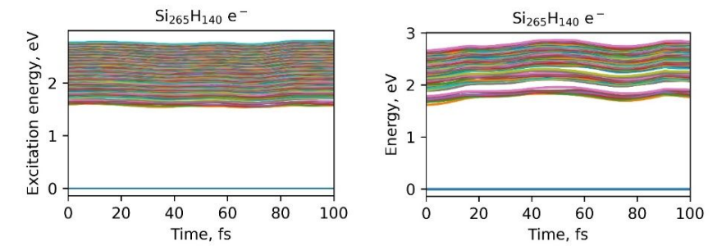
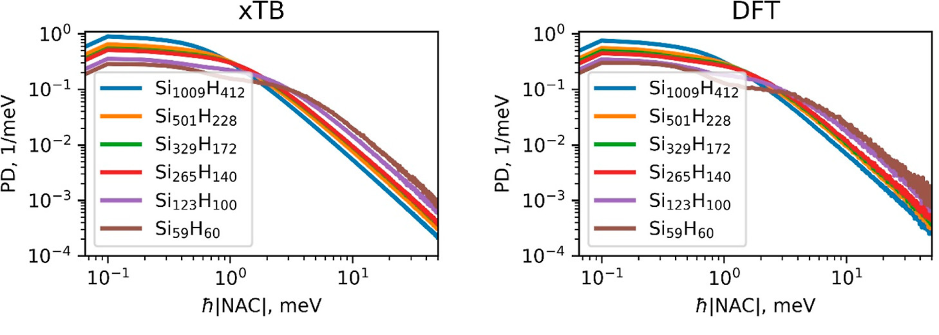
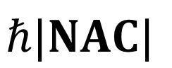
Hot-electron cooling dynamics in Si NCs
xTB
DFT
BLLZ size
??
Size
$$ℏ|NAC|$$
Bannwarth, Ehlert, Grimme, J. Chem. Theory Comput. 2019, 15, 1652–1671

Slide 10
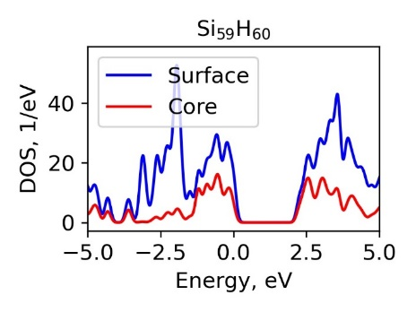
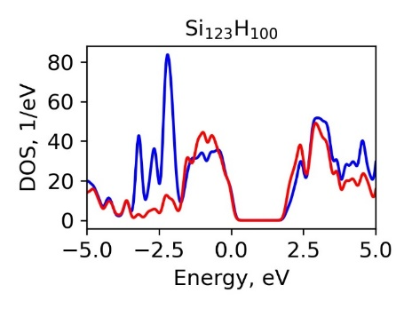
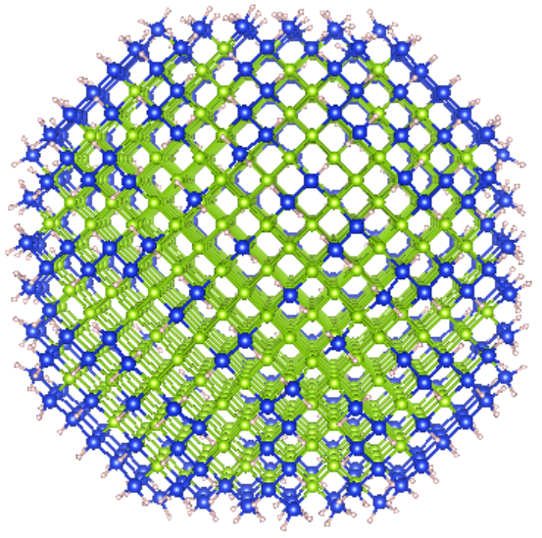
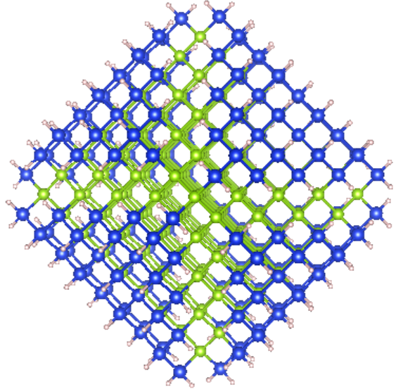
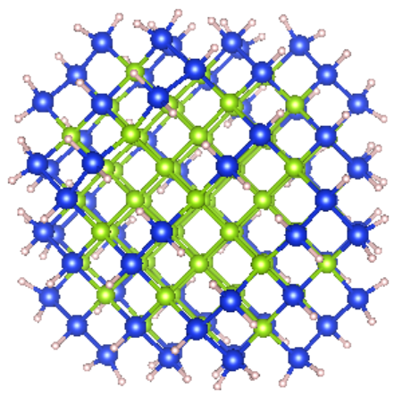
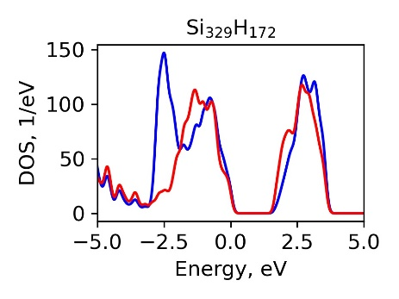
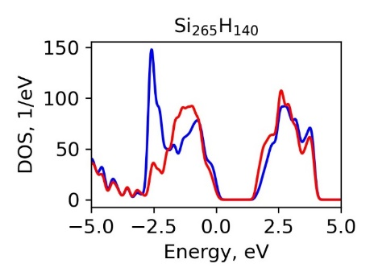
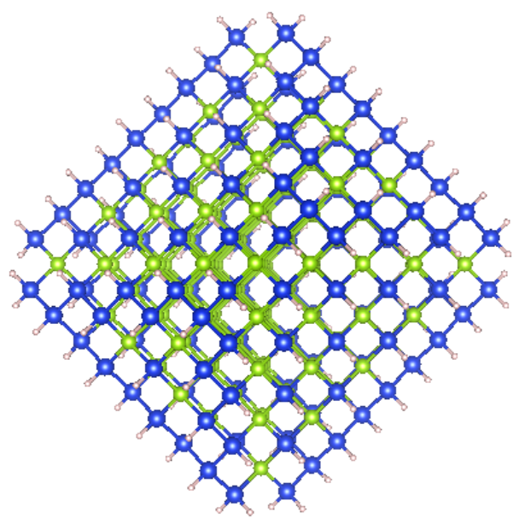
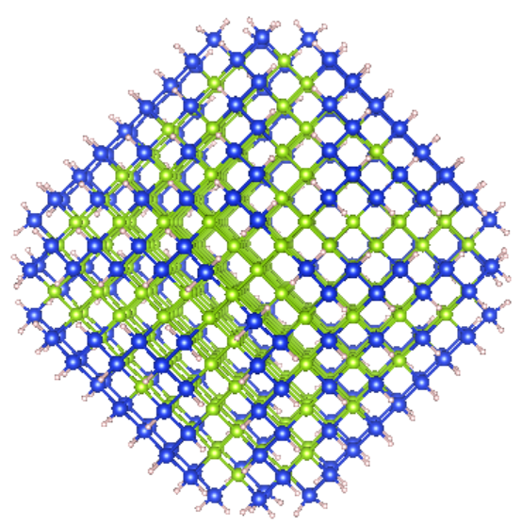
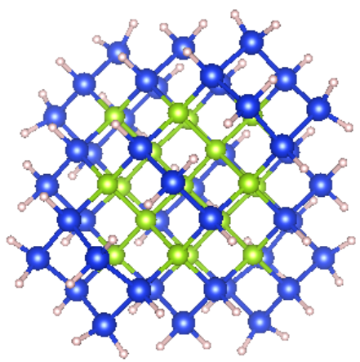
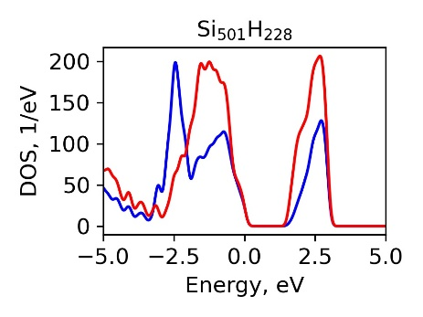
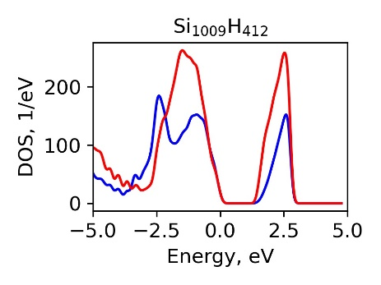
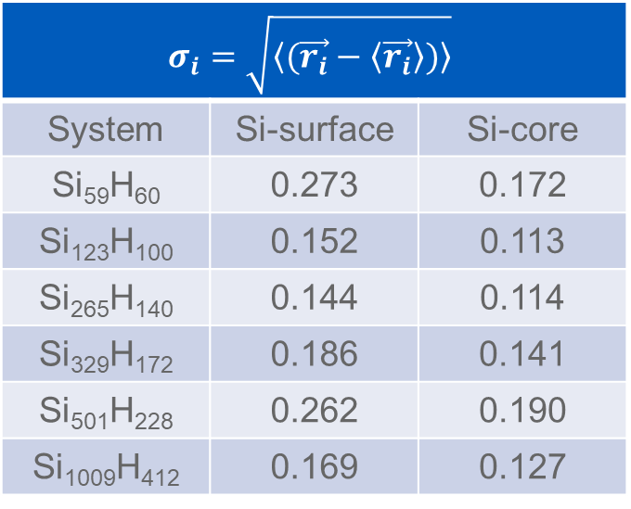
Core vs surface atoms
By increasing size the surface/core DOS decreases
Core atoms movements are slower than surface atoms
$$σ_{i}=\sqrt{\left\langle (\vec{r_{i}}−\left\langle \vec{r_{i}}\right\rangle )\right\rangle }$$
System | Si-surface | Si-core
Si₅₉H₆₀ | 0.273 | 0.172
Si₁₂₃H₁₀₀ | 0.152 | 0.113
Si₂₆₅H₁₄₀ | 0.144 | 0.114
Si₃₂₉H₁₇₂ | 0.186 | 0.141
Si₅₀₁H₂₂₈ | 0.262 | 0.190
Si₁₀₀₉H₄₁₂ | 0.169 | 0.127

Slide 11
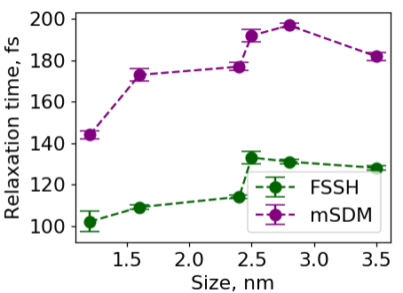
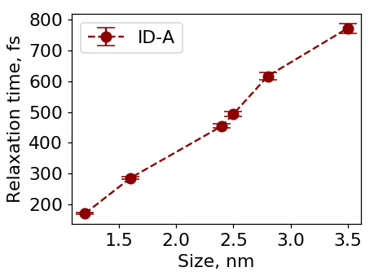
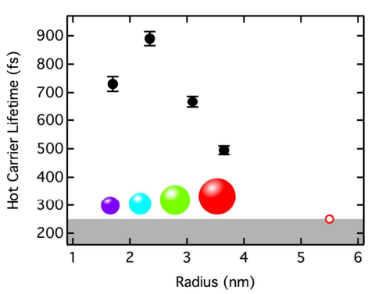
NA-MD results vs experiment
Experimental data show a non-monotonic dependence of the relaxation time with respect to NC size
FSSH and mSDM: Non-monotonic dependence of relaxation time on NC size
ID-A: Monotonic dependence of relaxation time with increasing NC size
Theory
Experiment
Bergren, Palomaki, Neale, Furtak, Beard, ACS Nano 2016, 10, 2316–2323

Slide 12
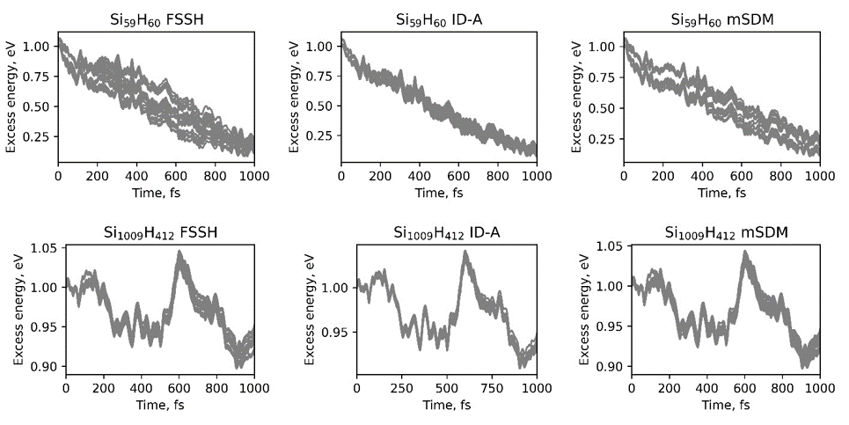
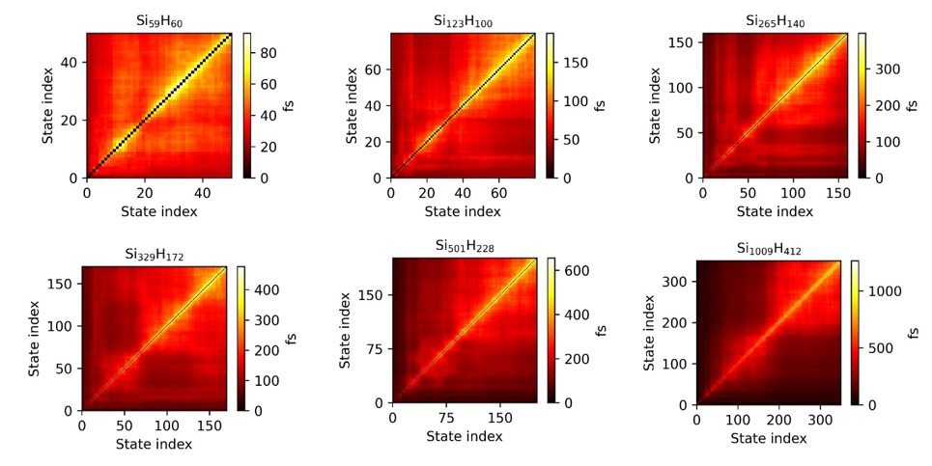
NA-MD results vs experiment
By going to larger NCs, the possibility of relaxation happening through non-adjacent states increase
NA-MD done with only adjacent state transition allowed does not decay for larger structures
FSSH and mSDM show comparable results but mSDM timescales are larger
mSDM and FSSH close timescales are due to relatively large dephasing times making correction to coherent amplitudes very small but the overall results are in a better agreement with experiments
Within the ID-A formulation, the overall coherent superposition collapses periodically to a given state, roughly to the one with the highest quantum population at the moment of collapse.
Because the greatest population transfer occurs due to multiple channels for non-adjacent state transitions, the ID-A collapses eﬀectively remove the parallel pathways by destroying the coherences between the non-adjacent states. As a result, we observe a steady increase of the ID-A energy relaxation times with the Si NC size increase

Slide 13
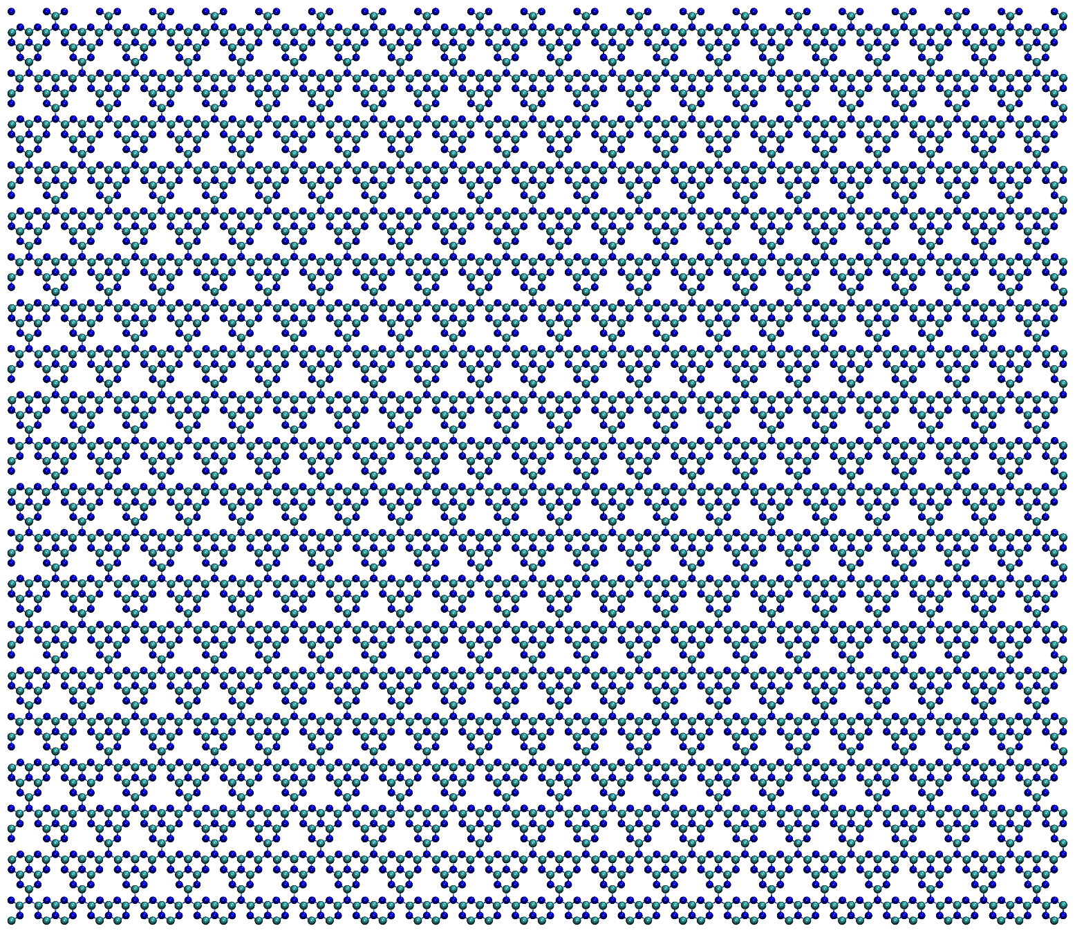
Charge carrier concentration in C₃N₄ monolayers
Intrinsic charge carrier concentration in monolayers are in the range of ~10¹⁰-10¹² cm⁻² in experimental studies
Theoretical studies overestimate this value due to simulation of excited states in small cell size
10x10
8x8
12.3 nm
6x6
224
# Atoms
5600
5x5
4x4
3x3
512
# Orbitals
12800
2x2
14.2 nm

Slide 14




e-h recombination dynamics in C₃N₄ monolayers
100 single-particle excitation states are built from all excitations from the first 10 occupied to the first 10 unoccupied molecular orbitals
NAC values decrease by increasing supercell size
Small time-overlaps between molecular orbitals in large supercells
Recombination dynamics becomes size-independent for all methods for very large supercell sizes
For FSSH and mSDM, the dynamics accelerates in the n-states model due to presence of more nonradiative channels for recombination
The dynamics is slower in ID-A in the n-states model due to presence of more nonradiative channels and therefore more frequent resets of the coherent amplitudes
For larger supercells, the DOS does not play an important role and the 2- and n-states model show similar results

Slide 15



e-h recombination dynamics in C₃N₄ monolayers
100 single-particle excitation states are built from all excitations from the first 10 occupied to the first 10 unoccupied molecular orbitals
NAC values decrease by increasing supercell size
Small time-overlaps between molecular orbitals in large supercells
Recombination dynamics becomes size-independent for all methods for very large supercell sizes
For FSSH and mSDM, the dynamics accelerates in the n-states model due to presence of more nonradiative channels for recombination
The dynamics is slower in ID-A in the n-states model due to presence of more nonradiative channels and therefore more frequent resets of the coherent amplitudes
For larger supercells, the DOS does not play an important role and the 2- and n-states model show similar results

Slide 16


e-h recombination dynamics in C₃N₄ monolayers

Slide 17

Summary
A new methodology for NA-MD simulations in large nanostructures and periodic solids is implemented in the open-source Libra code
The NAC values decrease by increasing Si NC size and C₃N₄ monolayer supercell size
A non-monotonic dependence of hot-electron relaxation dynamics on Si NC size was observed in FSSH and mSDM in agreement with experiment
Non-adjacent transitions play an important role in the relaxation dynamics in Si NCs
FSSH and mSDM showed similar dynamics in Si NCs due to high dephasing times
ID-A showed a monotonic dependence of the relaxation time on NC size which was due to multiple coherence resets in the dynamics
By varying charge carrier concentration using different supercell sizes, a saturation of the recombination timescale was observed showing the size-independence of recombination dynamics in very large structures
The results of the dynamics in the 2-states and n-states model showed that the inclusion of more states in the dynamics increases the recombination rate by providing more nonradiative channels for the dynamics in the FSSH and mSDM methods
ID-A showed slower dynamics in the n-states model compared to 2-states model due to frequent coherence resets in the dynamics

Slide 18








Acknowledgement
Prof. Alexey V. Akimov
Dr. Wei Li
Qingxin Zhang
Elizabethe Stippell

Slide 19
Thank You! Questions?

